Slide 1
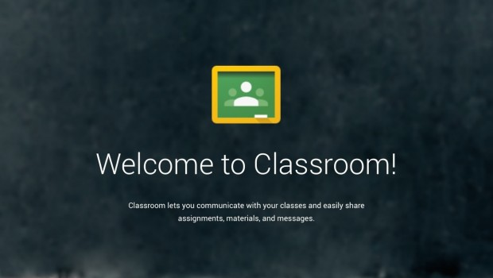
Google Classroom
Kelly Villa

Slide 2

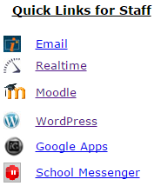
Double Click on Chrome Browser
Go to www.jefftwp.org
Click on Google Apps

Slide 3
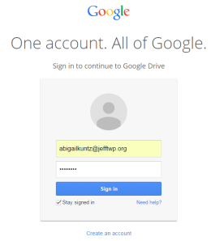
Type in Username: firstinitiallastname@jefftwp.org
Type in Password: (Same as Email)
Click Sign In
*Logging In – Must use your @jefftwp.org account to access Google Classroom

Slide 4
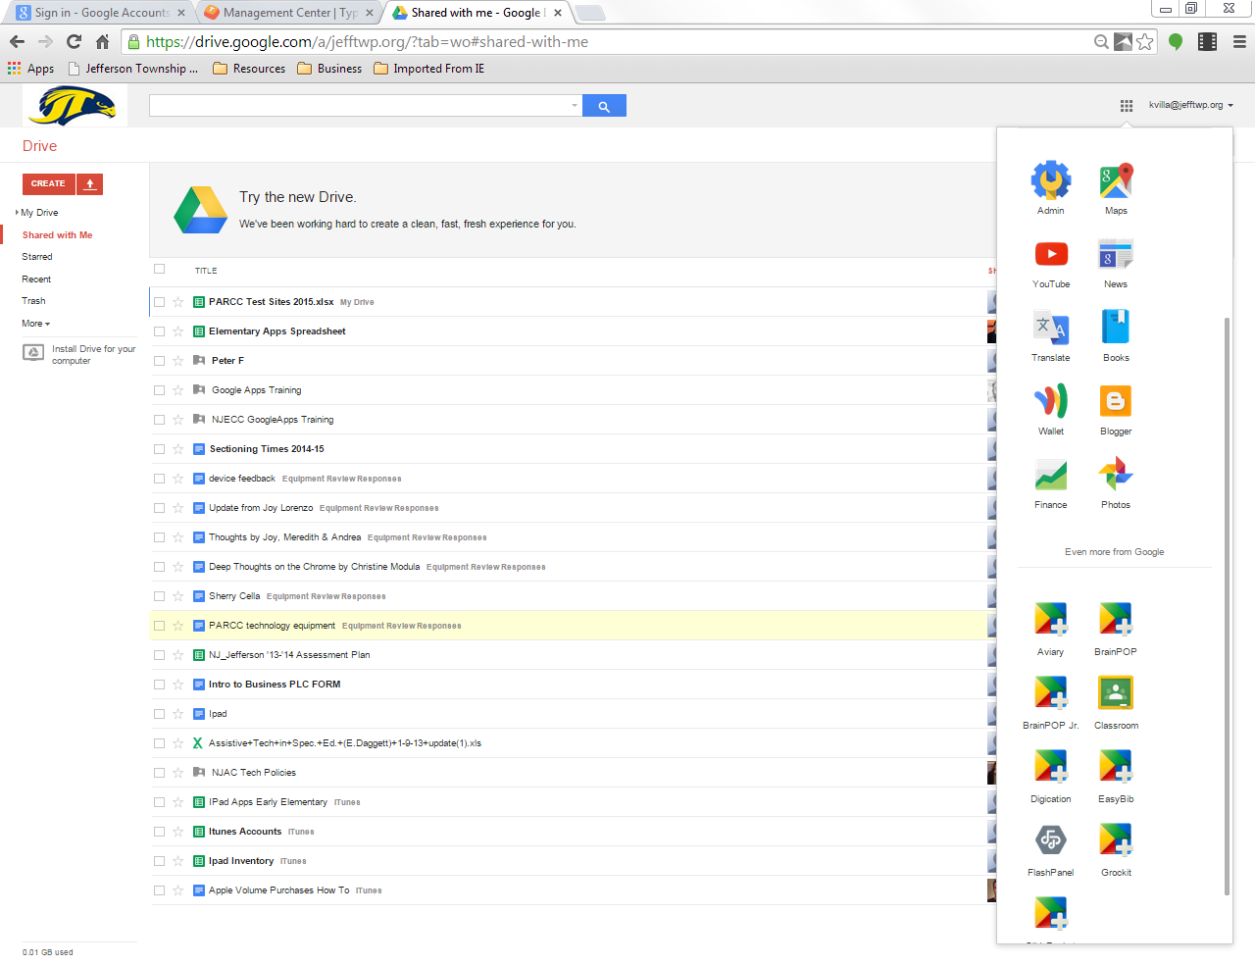
Click on
Click more or even more from Google
Click Classroom
*If Classroom is not there, open up a new browser window and search for Google Classroom

Slide 5
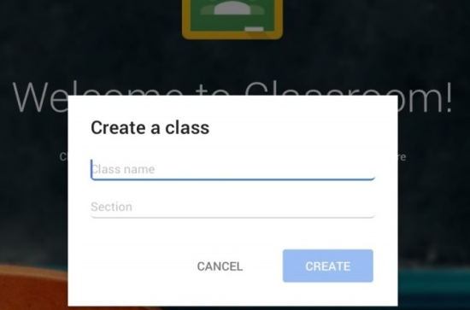
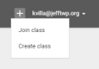
Set Up Class
Enter Basic Information
  Name of course
Click + sign to create a different classroom
  Create a different Classroom for each class or subject
  First Time Classroom Users Used Classroom Previously
  *Do Not Ask Students To Join Until Completely Set Up

Slide 6
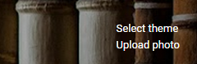
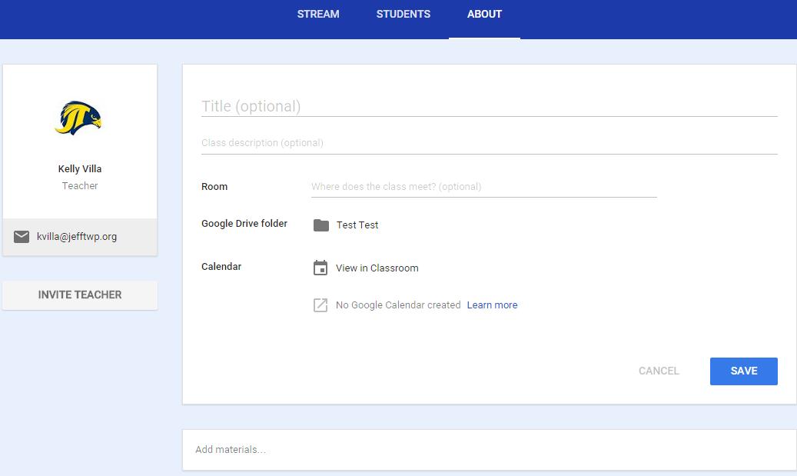
Theme & About Page
Click to Change Theme or Upload a Photo
Click on About
  Add a Title
  Add a Description
  Add Room Number
  Invite a Teacher
  Add Materials from
  Google Drive
    Reading List
    Websites
    Syllabus
*Google Drive folder that is automatically created for each course

Slide 7
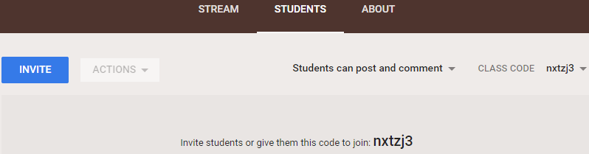
Students Page
Add Students
  Give Class Code
  Click Invite
Students need to sign in, then click the ‘+’ icon, click Join Class and enter course code.
Can Remove Students from this page too

Slide 8

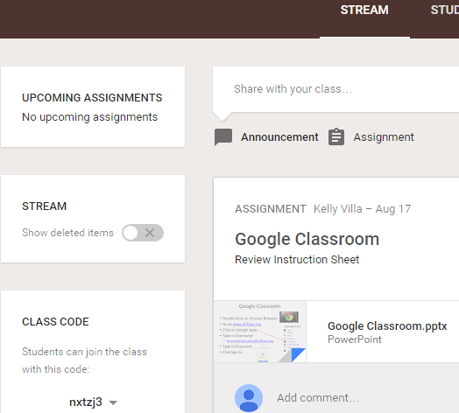
Stream Page
Add Assignments, Questions, Announcements by clicking on the sign
Widget on Left Sidebar in Stream shows upcoming assignments that are due.

Slide 9
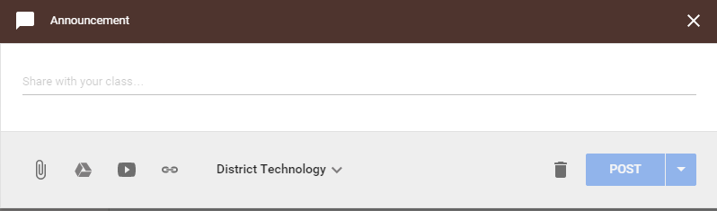
Stream Page
Click Create Announcement
  Attach a file, YouTube video, or a link
  Students can comment

Slide 10
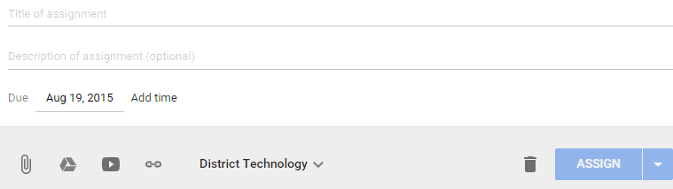
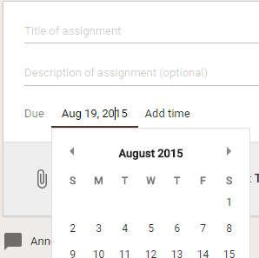
Stream Page
Click Create Assignment
  Title is required, but description is not
  Set due date

Slide 11
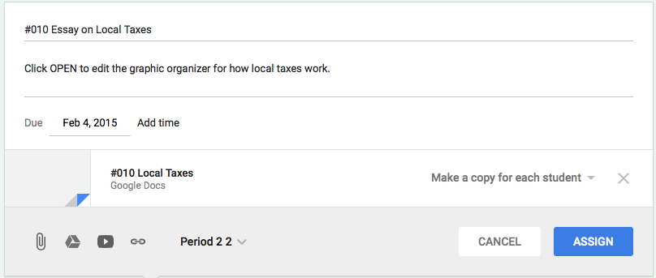
Stream Page
  When attaching a file, click “Make a copy for each student” and Click Assign (Can’t edit any longer, because students own it.)

Slide 12
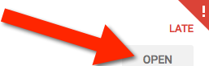
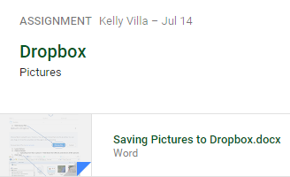
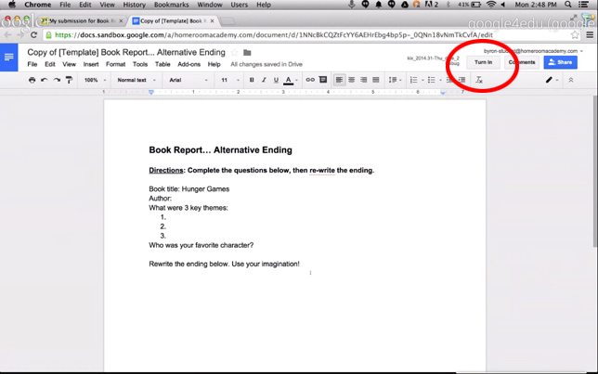
Stream Page
Student View and Teacher View are different
  Student must click “Open” to view the file
  Student view has a “Turn In” button that appears on assignment. Once submitted they can’t make changes until it is returned.
Student sees “OPEN” to view the attachment
Teacher sees Attachment in Stream

Slide 13
Stream Page
Grading & Returning Work
  View completed assignments by clicking on the assignment in your stream.
  The drive folder button will take you to the drive for that classroom. No need to access classroom to view student work.

Slide 14
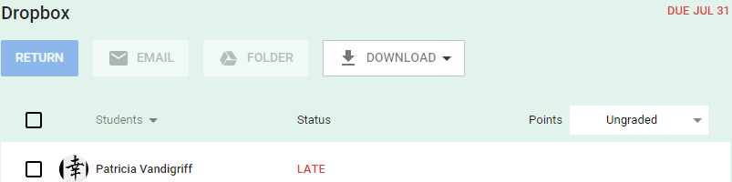
Stream Page
  Once you review, grade, and/or comment on a student’s assignment, you can click return.

Slide 15
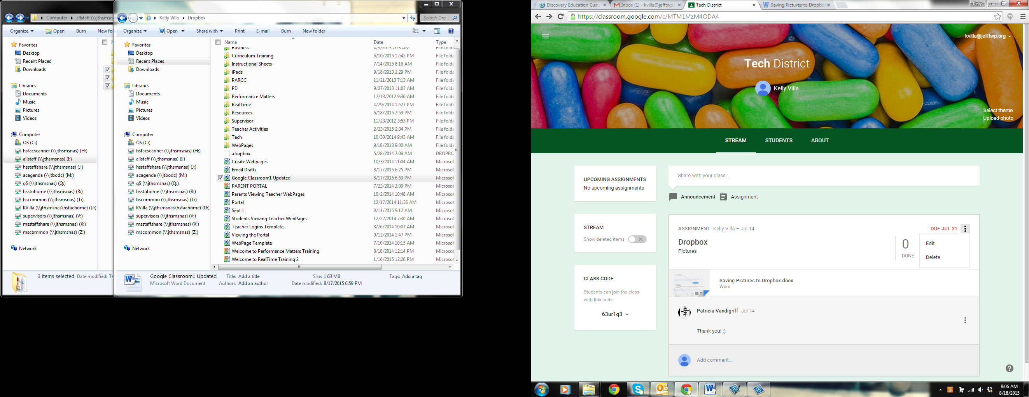
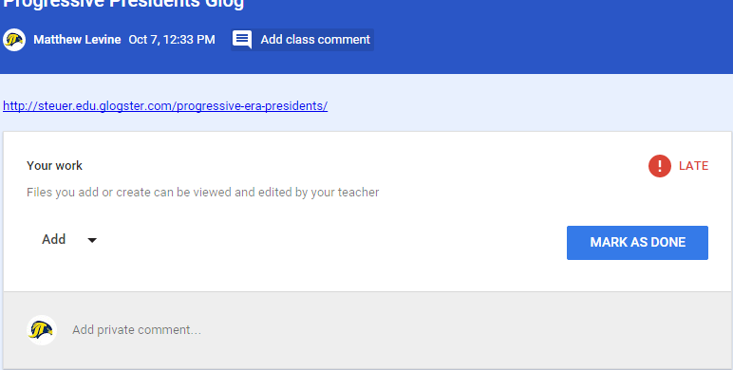
Stream Page
Click on to edit an assignment
Comments
  Add Class Comment is for everyone to see
  Add Private Comment is for only the teacher

Slide 16
Resources
https://edutrainingcenter.withgoogle.com/resources/tools/details?key=ahpzfmd3ZWItZWR1LXRyYWluaW5nLWNlbnRlcnIUCxIHRWR1VG9vbBiAgICAvMuKCgw

